Slide 1
“A Team” Project FINAL Report Presentation IFSC 54503 Fall 2025 Prof. Tudoreanu Hermes Abrantes Ram Ramanathan
Notes:
Good morning, This is Team A. Ram and Hermes. We are here to talk about our final project.

Slide 2
TASK DEFINITION
A user plans to move to a location in US and needs to find best place to live:
Which nearby Counties are most affordable based on rent to income ratio?
In a County, what are those specific market rents for different accommodation sizes?
Notes:
This slide outlines the crucial Task Definition guiding our project. Our work is centered around a very common scenario: a user plans to move to a location in the US and needs to find the best place to live in the state and around the workplace.
The project addresses this need by focusing on two primary questions. First, we tackle general affordability: Which nearby Counties are most affordable based on rent to income ratio? Analyzing this ratio is key to narrowing down the viable geographic area for the user.“ Second, once a county is identified, we provide the detailed data needed for decision-making. Specifically, in a County, what are those specific market rents for different accommodation sizes? This ensures the user has precise, granular data on housing costs for various units to decide as to which county they want to live in.

Slide 3

The Raw Data – Sourcing & Links (see video)
Median Household Income (MHI) per County, from U.S. Census’ American Community Survey (ACS) – 2024 & Other sources
https://data.census.gov/table/ACSST1Y2024.S1903?q=ACSST1Y2024.S1903&g=010XX00US$0500000,$1400000
Median Rent from Housing and Urban Development (HUD) Department’s Fair Market Rent (FMR) Survey, per County, per Rental Type – 2024
https://www.huduser.gov/portal/datasets/fmr.html#data_2024
Notes:
In order to find affordability by county, after extensive research the data was sourced from two credible sites – The Median Household Income per County from American Community Survey from Census.gov site and Median Rent per families from Housing and Urban Development (HUD) Department’s Fair Market Rent (FMR) Survey. You can find the links in this slide.

Slide 4
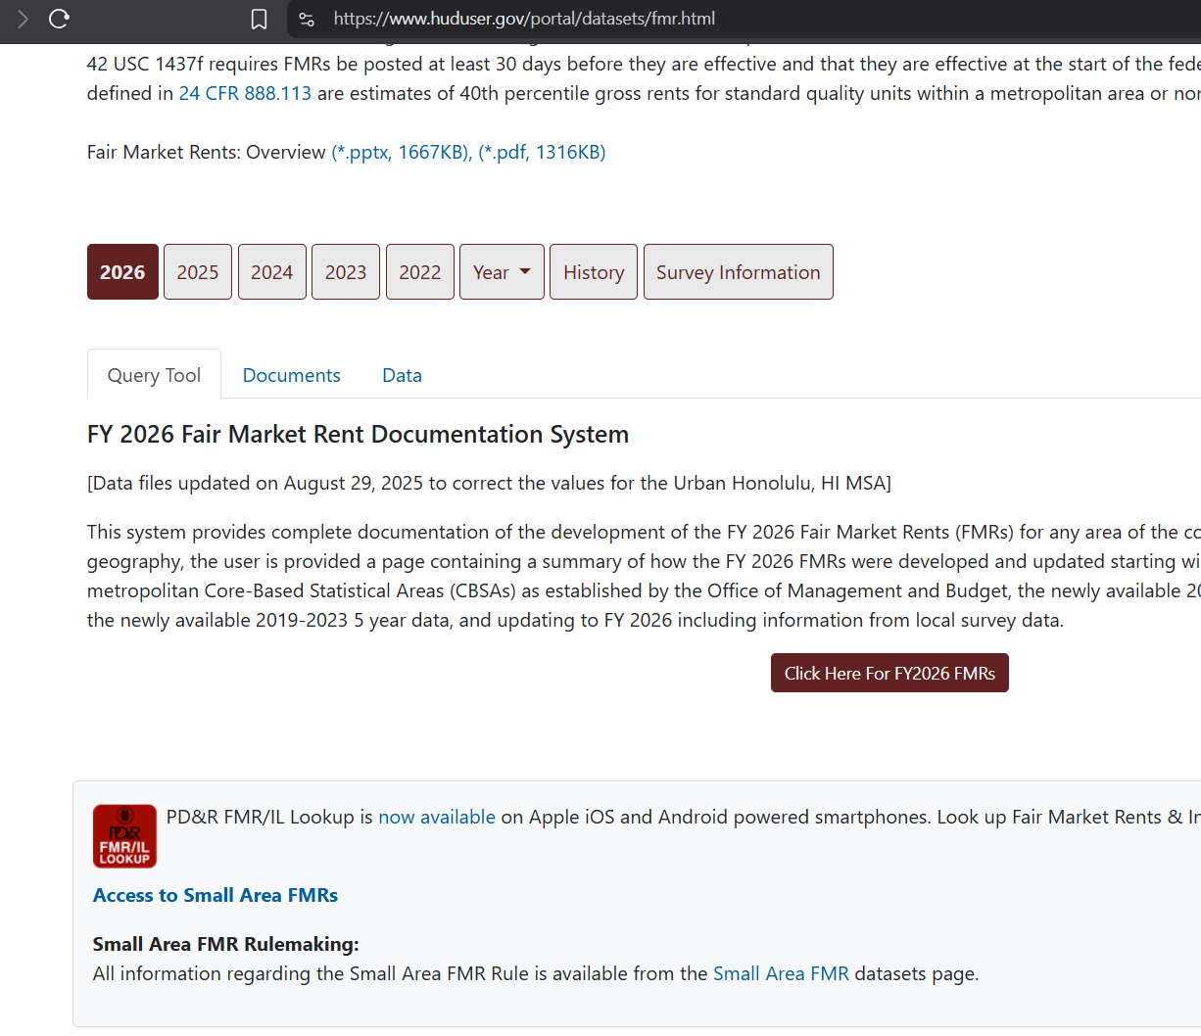
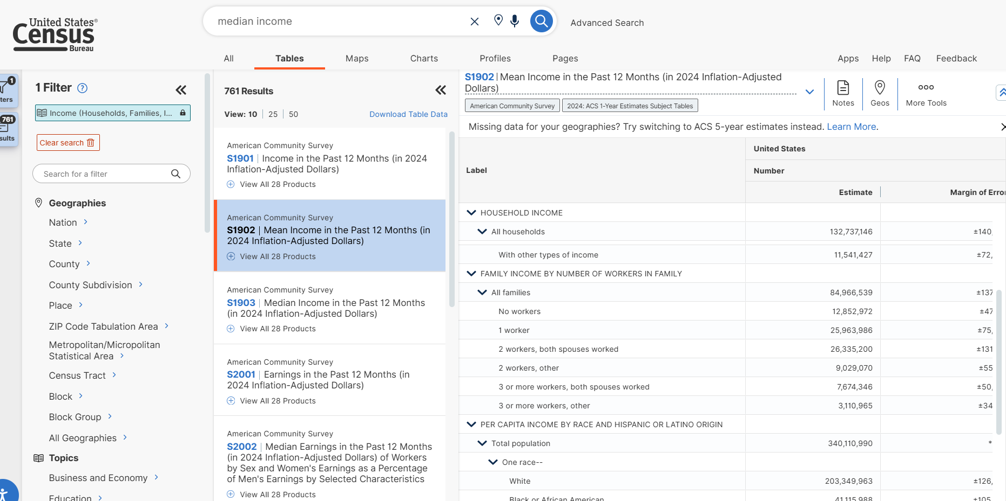
Data Sources
HUD Fair Market Rent
Census Median Income
Notes:
These are the two sites where the data was sourced for FMR (Fair Market Rent) and then Census Median Income.

Slide 5
Data Pre-processing for MHI
MHI – Median Household Income per County
Over 240 features, that were analyzed and simplified to : State, County, MHI value per County
Imputation of missing MHI values for certain counties via MHI estimates for those counties
FIPS code added and matched to correctly link with FMR data (next slide)
County names needed to be normalized for use in Visualization tool
Notes:
There are 240 features and some of the counties do not publish their median household income and in those cases we had to create a secondary file to source data for specific counties and map them to FMR data sets using FIPS and County names.

Slide 6
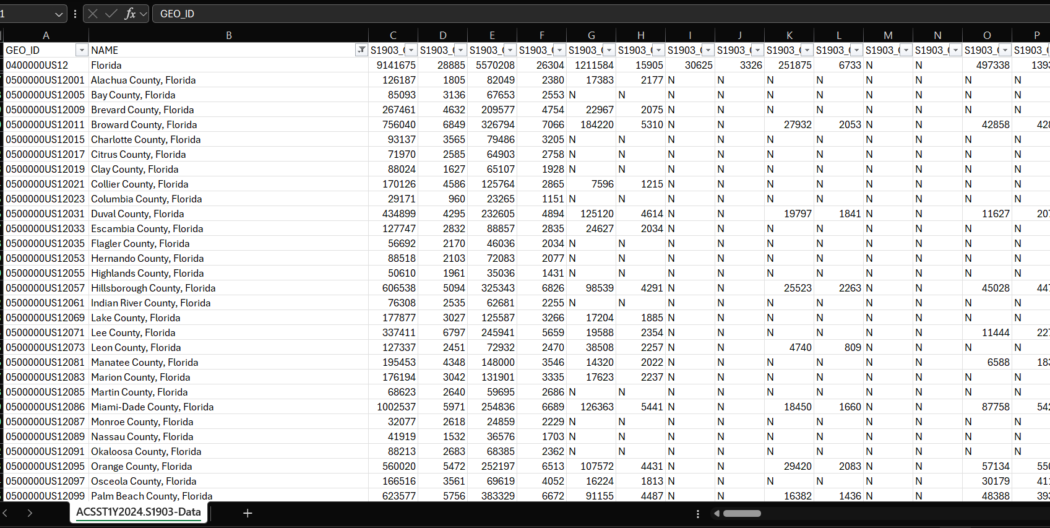
Census Median Household Income (MHI)
County Name
Income
Notes:
This is how the data looks like as said I will demo soon there are nearly 240 features that were to be analyzed and selected S1903_C03_S015E ‘Median Income (dollars) Families dataset.

Slide 7
Data Pre-processing for FMR
FMR – Federal Median Rent, per County
County names needed to be normalized for use in Visualization tool
RIR (Rent to Income Ratio) column added and computed in Visualization Tool based on the related MHI dataset
A pivot table had to be created to allow the tooltip functionality displaying the rents for each rental type for the county in focus on the map
Notes:
The FMR county names are used to connect the datasets and Rent to Income Ratio is a calculated field. A pivot table is created to allow the tool tip functionality to show up rents in the visualization tool.

Slide 8
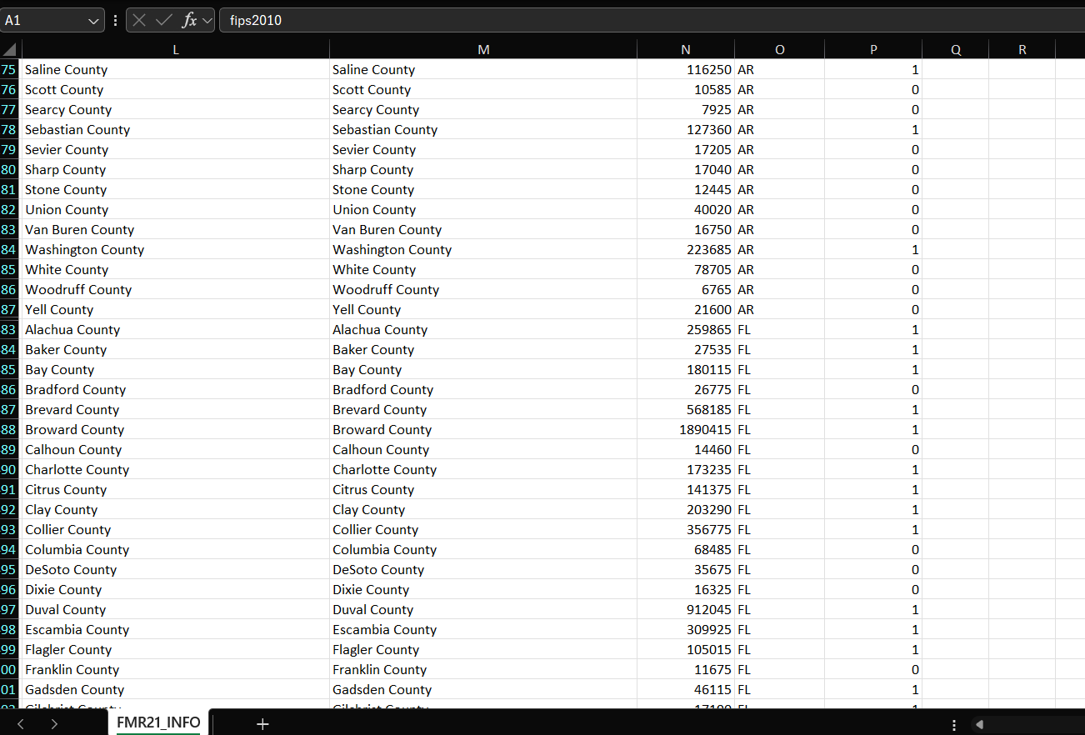
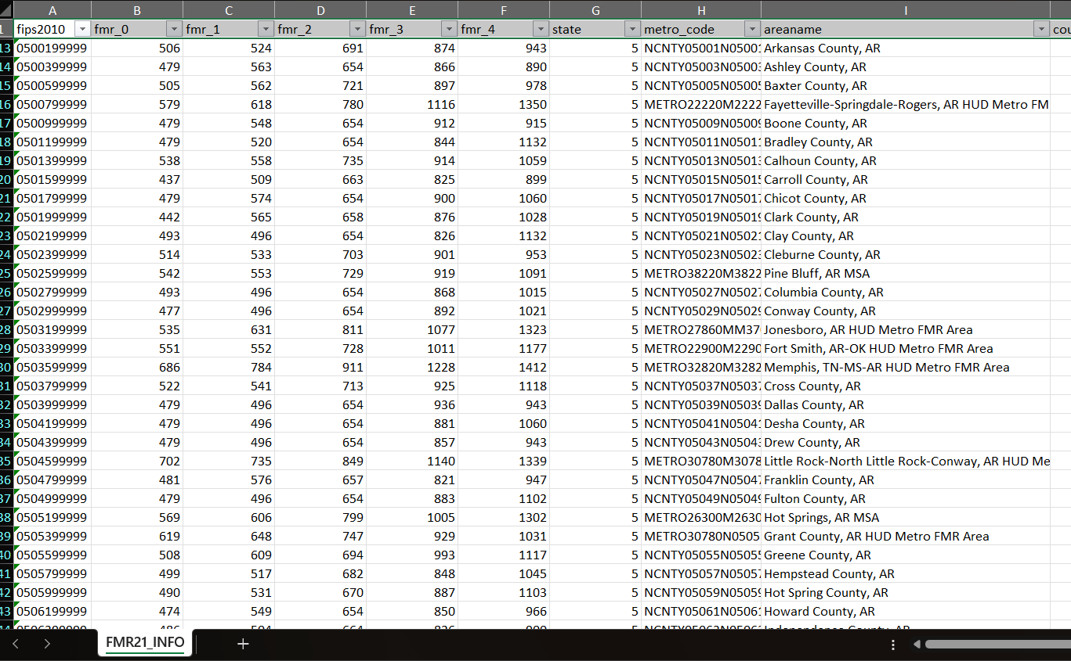
2021-2024
HUD Fair Market Rent (FMR)
County Name
State
Fair Market Rents – fmr_0 – Studio, fmr_1 – 1 bedroom, fmr_2- 2 bedroom, fmr_3 – 3 bedroom, fmr_4 – 4 bedroom
Population
Notes:
The HUD Fair market Rent contains data for studio all the way to 4 bedrooms.

Slide 9
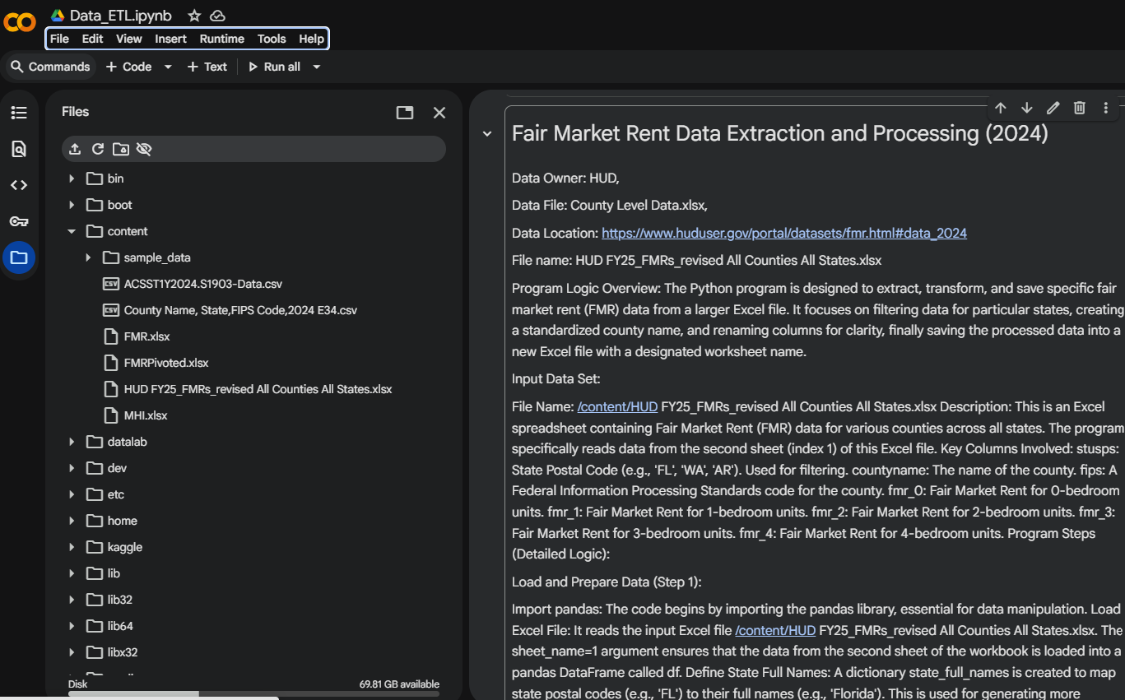
Google Colab Python Code for Data Processing (see video)
Insert Google Colab code here – may need more than one slde, but should not spend too much time on it
Notes:
There are three files that are needed by Python program to process datasets for visualization tool. For Median Housing Income had to use two files one primary and one secondary for missing MHI values for specific counties and FMR data sets are from HUD dataset. I will go over Python next in detail and show you how the three output files that become input for visualization tools are generated.

Slide 10
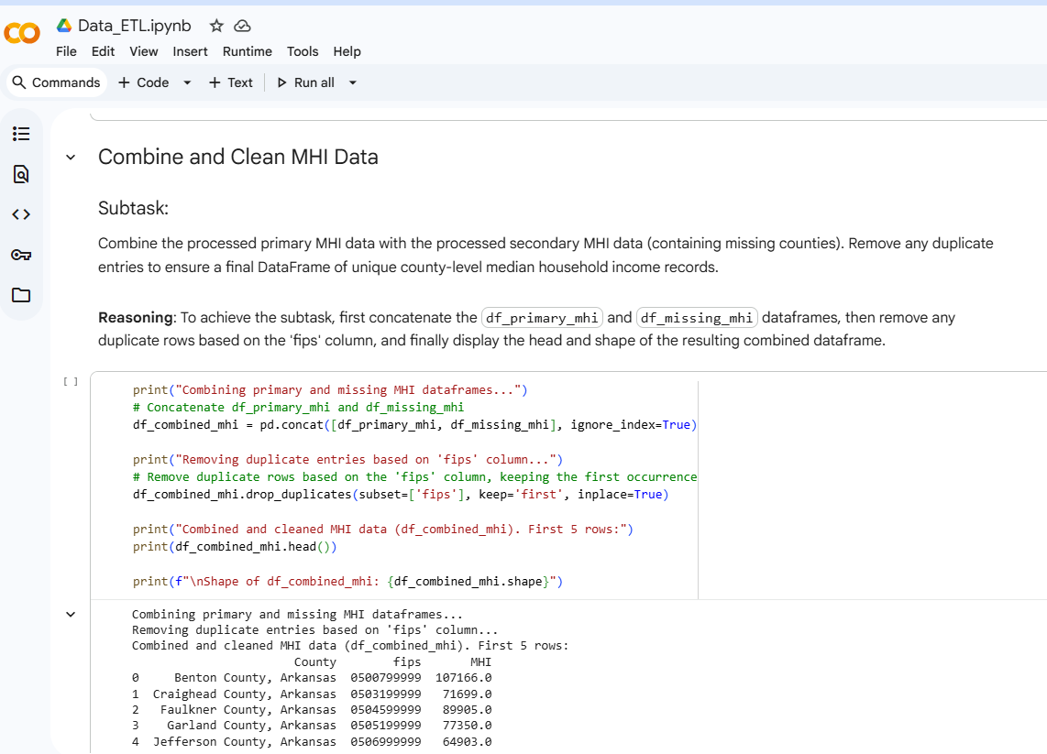

Slide 11
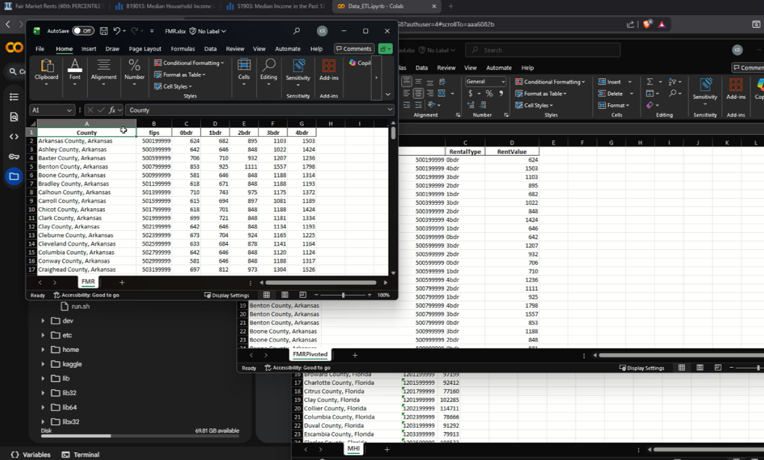

Slide 12
Alternative Analysis of Visualizations

Slide 13
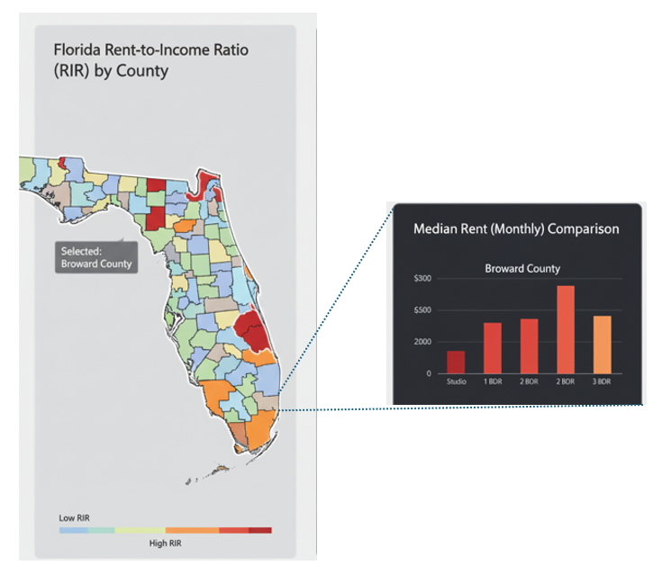
Visualization Alternative A - Hermes
Elements
State choropleth map
Color-coded counties by RIR (Rent-to-income Ratio)
County-coded ‘hover over’ Tooltip
Tooltip shows county’s median rents per rental type

Slide 14
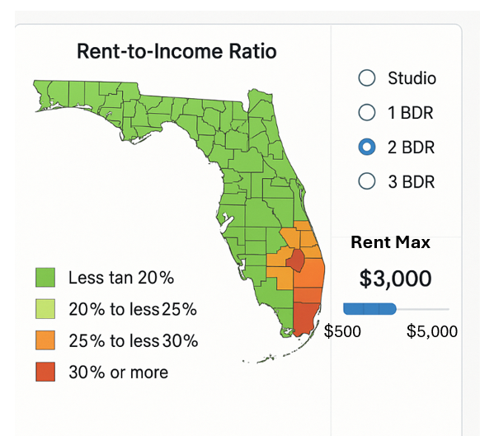
Visualization Alternative B - Hermes
Elements
State choropleth map
Focused on selected rental type (studio, 1 bdr, 2, bdr….)
Color-coded counties by RIR (Rent-to-income Ratio) for the selected rental type
Dial for selecting maximum rent willing to pay for rental type
County-coded ‘hover over’ Tooltip
Tooltip shows county’s median rents per rental type

Slide 15
Application of Visualization Principles
Information Visualization
Discovery
Decision-making
Learning and
Presentation
Visualization Process
Representation (encoding)
Presentation (selection)
Interaction (navigation)
Human Performance (perception)
Gestalt Psychology
Proximity
Similarity
Tufte Principles of Graphical Excellence
Maximize data-ink ratio
Avoid Chart junk
Schneiderman’s Mantra
Overview first
Zoom and filter
Details on demand.
Uni and Multidimensional data – Relevance
Large data sets visualization
Focus
Context

Slide 16
Analysis of Visualization Alternatives
Alternative A
Alternative B
Pros:
Simple, straightforward
Sufficient for proposed task
Easier to implement
Simpler for user to interact
Cons:
Less detailed control for user
Pros:
More detailed control for user
Cons:
Too many things to “click”
Harder for user to understand
More complex to implement
Overdone for the task at hand

Slide 17
Alternative Analysis of Visualization Tools

Slide 18
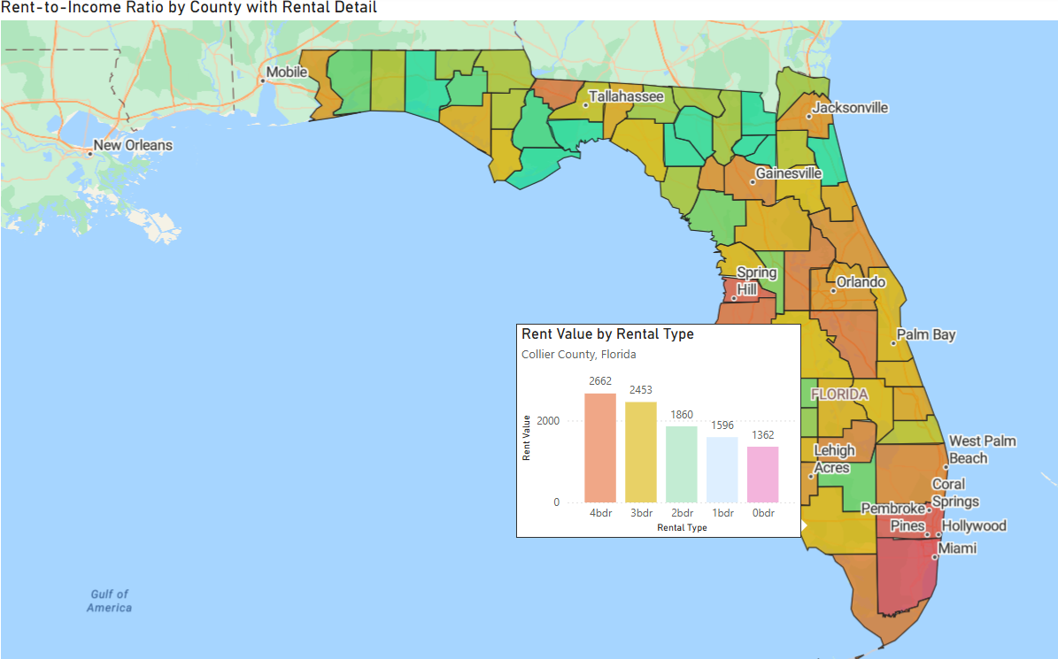
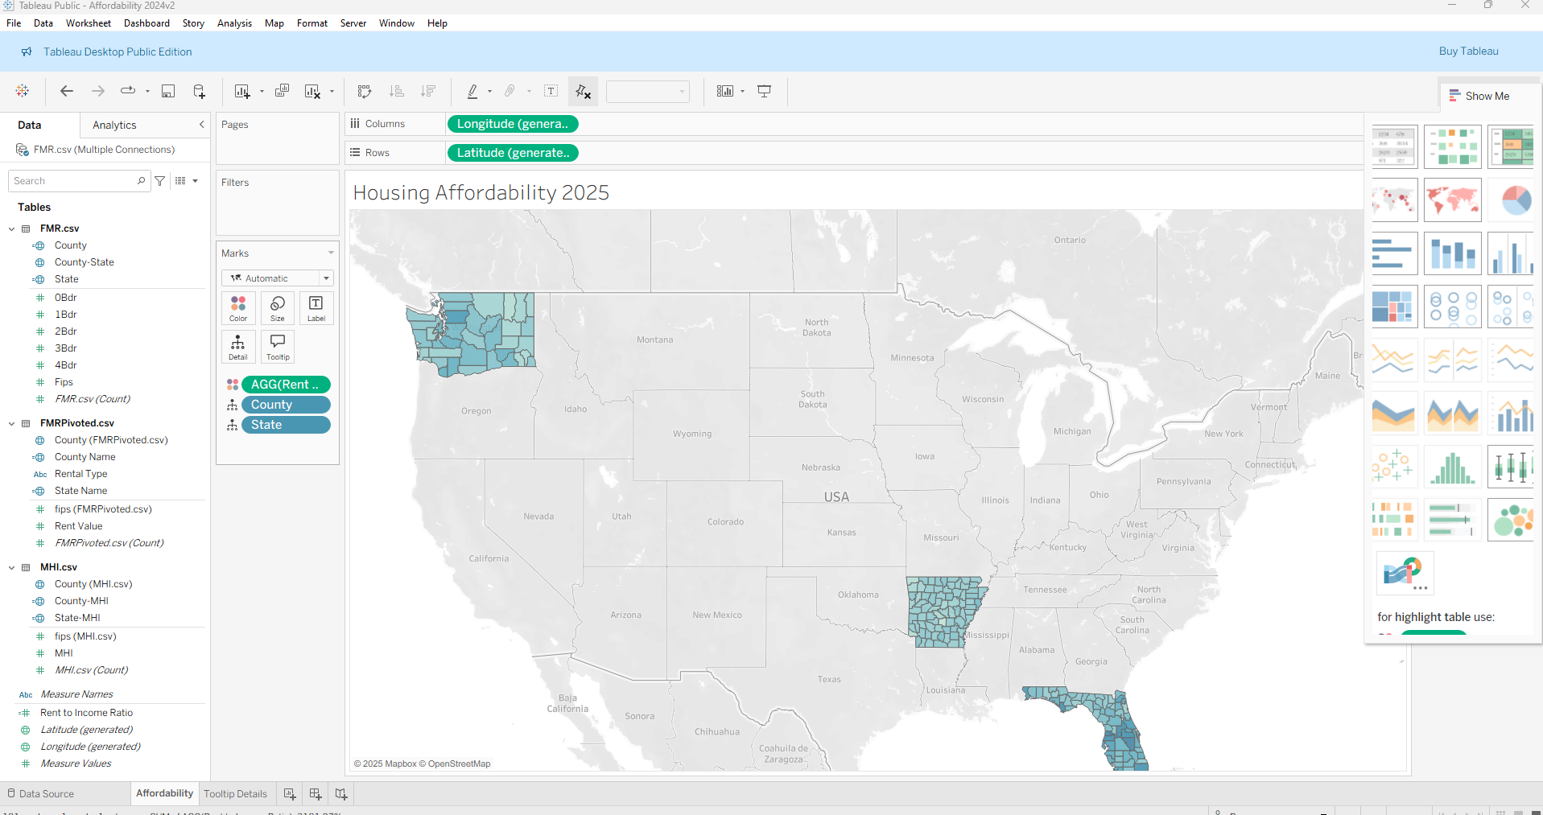
Visualization Tool Alternatives
Power BI
Tableau

Slide 19
Visualization Tool Alternatives - Demos
Tableau Visualization
Power BI Visualization
Visualization Tool Selection Process

Slide 20
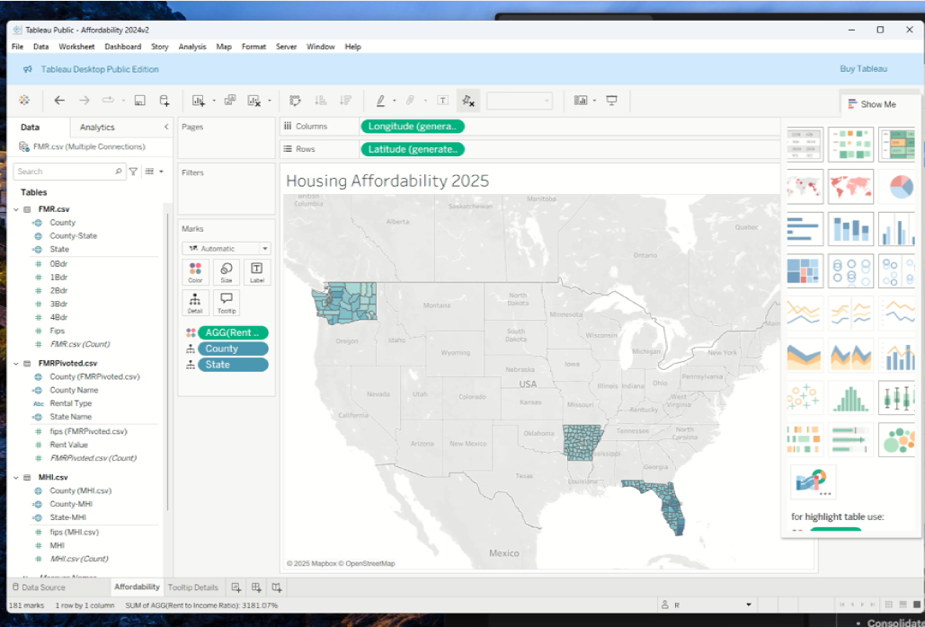
Tableau Demo (see video)
https://public.tableau.com/app/profile/chandrasekaran.ramanathan/viz/Affordability2024v2/Affordability?publish=yes

Slide 21
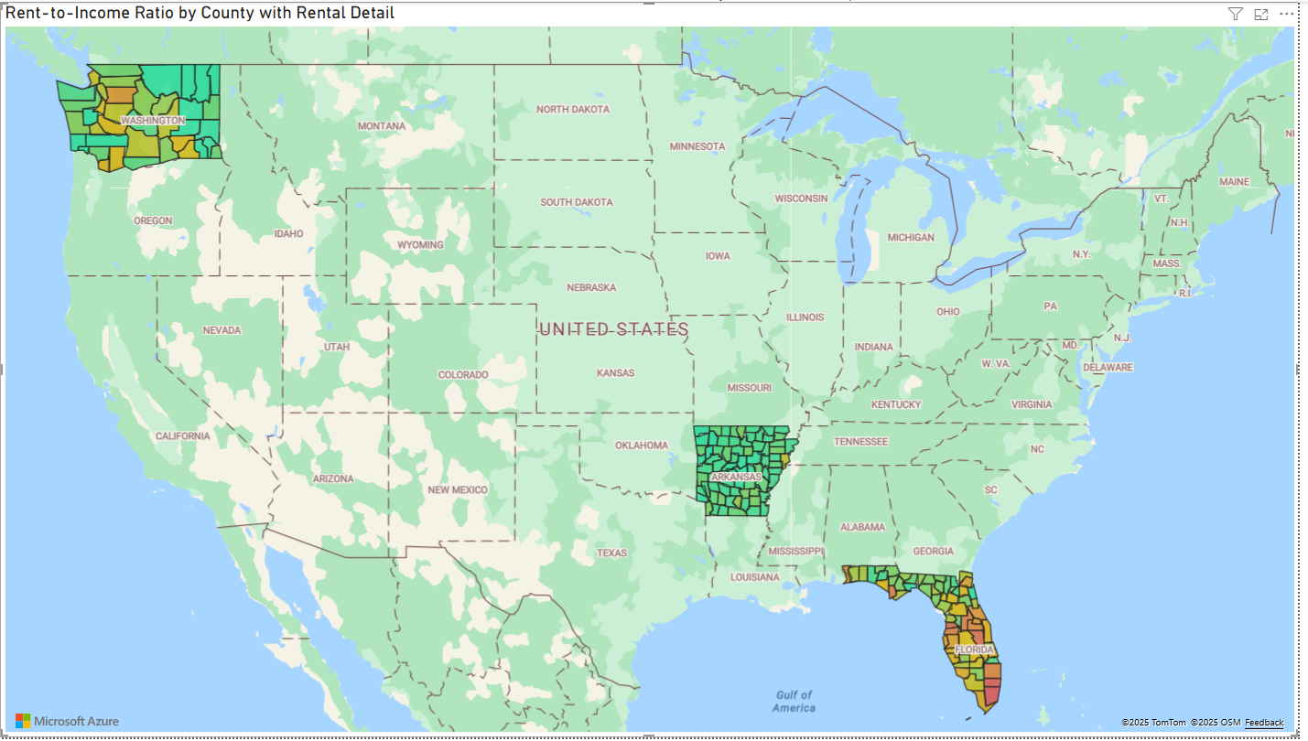
Power BI Visualization (see video)

Slide 22
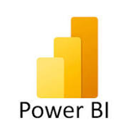

Analysis of Tool Alternatives
Power BI
Tableau
Pros:
Easy to create choropleth map
Tooltip solution straightforward to implement
Easier to operate than Tableau
Cons:
Manual data manipulation often required
New columns needed DAX syntax
Pros:
Easier to customize basic visuals
Drag and drop interface
Cons:
Very weak data preparation layer
Steep learning curve for Level of Details (LOD) expressions
Harder to operate than Power BI
Notes:
Cons – Tableau has a weak integrated data prep layer when compared to Power BI.
PowerBI uses PowerQuery while in Tableau ETL or SQL work had to be created in the tool.
Tableau has its own proprietary calculation language called Level of Detail (LOD) expressions for any advanced logic. It is not intuitive like DAX and involves steep learning curve to master.

Slide 23
Instruction on how to Visualize our Solution
Install Free Power BI Desktop from https://www.microsoft.com/en-us/power-platform/products/power-bi/desktop
Then Double Click on the .pbix file sent with this submission packet _A Team Info Visualization Final Project Report.pbix
Should be able to navigate as demonstrated in the video presentation

Slide 24
Team Member Contributions – Hermes Abrantes
Weekly team meetings
Task definition
Project proposal
Overall planning & coord.
Visualization options
Alternatives analyses
Power BI visualizations
Presentations drafting
QA data pre-processing
Data ingestion into Power BI
Design report
Final project report

Slide 25
Team Member Contributions – C. Ramanathan
Weekly team meetings
Project proposal
Task definition
Data retrieval
Data pre-processing
Google Colab python coding
Tableau visualizations
Discussion visualizations
Definition of visualization tool
Timeline review & next steps
Design report
Final project report

Slide 26
Thank You

